Slide 1
A Brief Introduction to The Puppet Forge & Modules
Find, Install, and Apply
Michael Jenkins michael@managedkaos.com

Slide 2
Goals
Find the modules we need by searching the Puppet Forge
Install the modules from the command line
Apply the modules and verify system operation
Notes:
Install Apache, configure the vhost, and serve content from GitHub

Slide 3
https://forge.puppetlabs.com
Puppet Forge
“A repository of modules written by the community and Puppet Labs.”
Puppet Module
“Modules are reusable, sharable units of Puppet code.”

Slide 4
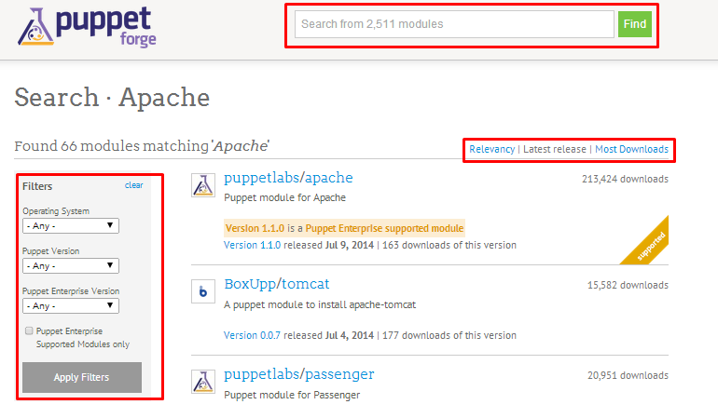
Find Modules – Search, Sort, Filter
Search on keywords; Sort by details; Filter on OS and Versions, and Supported Modules

Slide 5
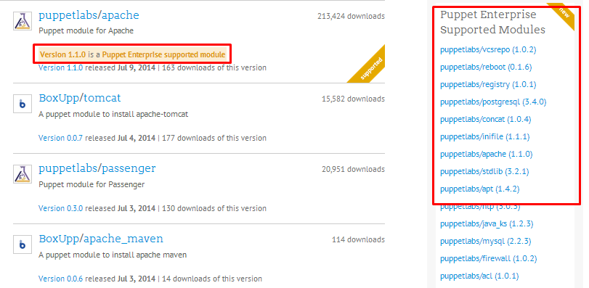
Find Modules – Choosing the right one
Research; Experimentation; Puppet Supported Modules

Slide 6
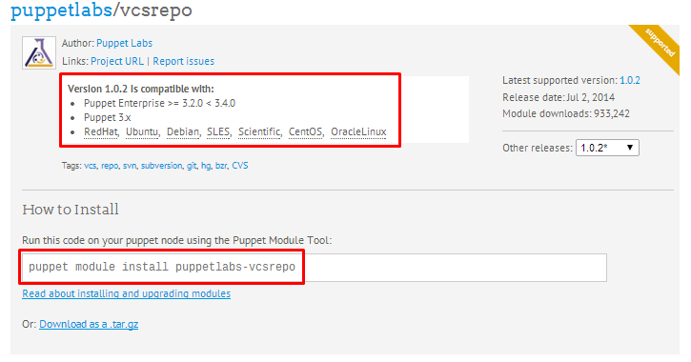
Find Modules – Check compatibility and installation details
Notes:
For our goal, use the puppetlabs sponsored modules for apache and vcsrepo:
puppetlabs/apache
puppetlabs/vcsrepo

Slide 7
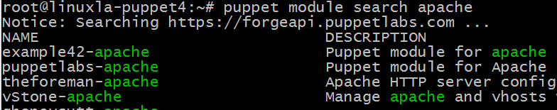
Find Modules
Search the Puppet Forge from the command line too:
$ puppet module search apache
Notes:
Use the “module search” commands to find the module
Does not have options for filtering or sorting results by default

Slide 8
Install Modules
Use the puppet command with “module install <module name>”
# puppet module install puppetlabs-apache
Installation locations:
Root – /etc/puppet/modules
User – /home/username/.puppet/modules

Slide 9
Install Modules
# puppet module install puppetlabs-apache
Notice: Preparing to install into /etc/puppet/modules
Notice: Downloading from https://forgeapi.puppetlabs.com
Notice: Installing -- do not interrupt ...
/etc/puppet/modules
└─┬ puppetlabs-apache (v1.1.0)
├── puppetlabs-concat (v1.1.0)
└── puppetlabs-stdlib (v4.2.2)

Slide 10
Install Modules
Display the modules that are installed with “module list”
# puppet module list
/etc/puppet/modules
├── puppetlabs-apache (v1.1.0)
├── puppetlabs-concat (v1.1.0)
├── puppetlabs-stdlib (v4.2.2)
└── puppetlabs-vcsrepo (v1.0.2)

Slide 11
Apply Modules
Call out installed modules in a puppet manifest
$ vi apache-vcsrepo.pp
# instantiate the apache class
class { 'apache': }
# clone the repository
vcsrepo { $docroot: …}
$ sudo puppet apply apache-vcsrepo.pp

Slide 12
Apply Modules
Confirm that the modules were applied properly with “puppet resource” command (or built-in commands)
Package:
puppet resource package git
Service:
puppet resource service apache2
File:
puppet resource file /www

Slide 13
DEMO
Install the latest version of Puppet Enterprise
Check the environment before we install and apply modules
Install apache and vcsrepo modules; Draft and apply a manifest
Check the environment to confirm and validate the installations

Slide 14
BACKUP INFO

Slide 15
Demo Step #1: Install
# Install Puppet (on Ubuntu 12.04 LTS)
wget https://apt.puppetlabs.com/puppetlabs-release-precise.deb
dpkg -i puppetlabs-release-precise.deb
apt-get update
apt-get install -y puppet
puppet --version

Slide 16
Demo Step #2: Pre-Check
# Check the Environment Before installing and applying modules
puppet module list
which git
puppet resource package git
service apache2 status
puppet resource service apache2
curl -s -w "%{http_code}\n" -o /dev/null `hostname`.cloudapp.net

Slide 17
Demo Step #3: Post-Check
# Install the modules and apply a puppet manifest
puppet module install puppetlabs-vcsrepo
puppet module install puppetlabs-apache
wget https://raw.githubusercontent.com/managedkaos/puppet-forge-intro/master/apache-vcsrepo.pp
sudo puppet apply apache-vcsrepo.pp

Slide 18
Demo Step #4: Install Modules
# Confirm that the modules, applications, and site are installed
puppet module list
puppet resource package git
service apache2 status
puppet resource service apache2
curl -s -w "%{http_code}\n" -o /dev/null `hostname`.cloudapp.net

Slide 19
Fixing the “templatedir” Warning
If you run commands as root on a new install and see:
Warning: Setting templatedir is deprecated.
See http://links.puppetlabs.com/env-settings-deprecations
(at /usr/lib/ruby/vendor_ruby/puppet/settings.rb:1095:in `issue_deprecations')
Edit puppet.conf and comment out “templatedir=$confdir/templates”
$ sudo vi /etc/puppet/puppet.conf
This provides a quick fix for an annoyance but may introduce other issues!

Slide 20
Installing Modules from Source
Using “puppet module install” command may not always be an option
Examples: Disconnected networks, firewalls, local development
Modules can be downloaded from the forge and installed manually
http://docs.puppetlabs.com/puppet/latest/reference/modules_installing.html#installing-from-a-release-tarball
$ puppet module install <module name>.tar.gz --ignore-dependencies
Dependencies will have to be installed manually as well

Slide 21
Puppet Help and Manual Pages
puppet help module – usage and overview
puppet man module – detailed information, subcommands, options
puppet help module search – usage and overview for the search subcommand

Slide 22
Apply Modules
Confirm that the modules were applied properly with “puppet resource package/service/file” command (or built-in commands)
$ puppet resource service apache2
$ service apache2 status

Slide 23
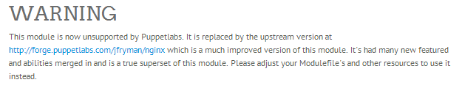
Not all Supported Modules are Created Equally
puppetlabs/nginx replaced by jfryman/nginx

